Slide 1
Cioppino: Multi-Tenant Crowd Management
Daniel Haas
Michael J. Franklin
HCOMP 2017
Quebec City, Québec
October 26th, 2017

Slide 2
Today’s systems need labeled data, fast.

Slide 3
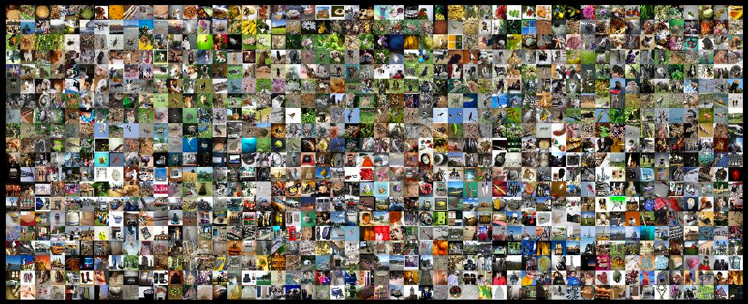

Supervised learning

Slide 4

Data cleaning
=
?
iPhone 4s 16GB (White)
White iphone 4S 16
Entity Resolution

Slide 5

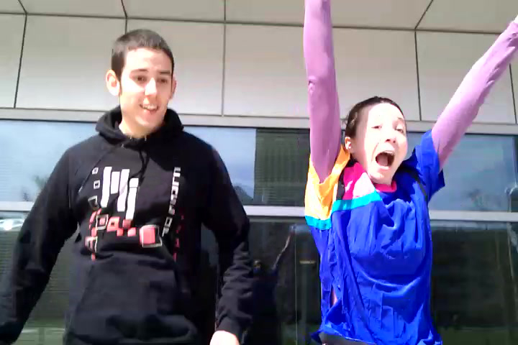
Real-time applications
Answering visual questions for blind users
[Bigham et al. 2010]
Crowd-assisted photography
[Bernstein et al. 2011]

Slide 6
The retainer model
Incoming Tasks
Worker Pool
…
…
…
Workers are paid to be idle…
[Bernstein et al. 2011]

Slide 7
The retainer model
Incoming Tasks
T2
T1
Worker Pool
…
…
…
Until work arrives!
[Bernstein et al. 2011]

Slide 8
The retainer model
Incoming Tasks
Worker Pool
T2
…
T1
Until work arrives!
[Bernstein et al. 2011]

Slide 9
Key insight:
a crowd is a distributed system!

Slide 10
Key insight:
a crowd is a distributed system!
^
not quite

Slide 11
Multi-tenant crowds
Image labeling
T2
T1
Worker Pool

Slide 12
Multi-tenant crowds
Data Cleaning
T2
T1
Image labeling
Worker Pool
T2
T1
Worker Pool

Slide 13
Multi-tenant crowds
Data Cleaning
T2
T1
Image labeling
Content Moderation
Worker Pool
T2
T2
T1
T1
Worker Pool
Worker Pool

Slide 14
Multi-tenant crowds
Data Cleaning
Real-time Photography
T2
T2
T1
T1
Image labeling
Content Moderation
Worker Pool
Worker Pool
T2
T2
T1
T1
Worker Pool
Worker Pool

Slide 15
Multi-tenant crowds
Image labeling
Data Cleaning
Content Moderation
Real-time Photography
T2
T2
T2
T2
T1
T1
T1
T1
Multi-tenant Crowd
Worker Pool
Worker Pool
Worker Pool
Worker Pool

Slide 16
Analogy: multi-tenant clouds

Slide 17
Multi-tenant crowds: challenges
Traditional systems challenges:
How many workers are needed for each application?

Slide 18
Multi-tenant crowds: challenges
Traditional systems challenges:
How many workers are needed for each application?
Can we adapt the pool size as workloads change?

Slide 19
Multi-tenant crowds: challenges
Traditional systems challenges:
How many workers are needed for each application?
Can we adapt the pool size as workloads change?
Crowd systems challenges:
Should we recruit new workers or re-train idle ones?

Slide 20
Multi-tenant crowds: challenges
Traditional systems challenges:
How many workers are needed for each application?
Can we adapt the pool size as workloads change?
Crowd systems challenges:
Should we recruit new workers or re-train idle ones?
Can we assign workers to work they prefer?

Slide 21
Solution: the Cioppino model
Client Application
Client Application
Requests
Requests
Multi-tenant Crowd

Slide 22
Solution: the Cioppino model
Client Application
Client Application
Requests
Requests
Task Queue
Task Queue
Multi-tenant Crowd
T3
T2
T1
T1
Worker Pool
Worker Pool

Slide 23
Solution: the Cioppino model
Client Application
Client Application
Requests
Requests
Task Queue
Task Queue
Multi-tenant Crowd
T3
T2
T1
T1
Worker Pool
Worker Transfer
Worker Pool

Slide 24
Solution: the Cioppino model
Client Application
Client Application
Requests
Requests
Task Queue
Task Queue
Multi-tenant Crowd
T3
T2
T1
T1
Worker Pool
Worker Transfer
Worker Pool
Worker
Recruitment
Crowd Platform

Slide 25
Solution: the Cioppino model
Client Application
Client Application
Requests
Requests
Task Queue
Task Queue
Multi-tenant Crowd
T3
T2
T1
T1
Worker Pool
Worker Transfer
Worker Pool
Worker
Recruitment
Worker Abandonment
Worker Abandonment
Crowd Platform

Slide 26
Approach
Model tasks, workloads, and worker behavior
Auto-scale the pool to match incoming tasks:
Queuing theory to model task processing
Control theory to adapt to changing workloads
Inter-pool worker transfer:
to maximize cost-efficiency and throughput
to assign workers to tasks they prefer
Evaluation:
Simulations on traces from a large scale retainer pool deployment
19x cheaper, 20% higher throughput
Takes worker preferences into account

Slide 27
Approach
Model tasks, workloads, and worker behavior
Auto-scale the pool to match incoming tasks:
Queuing theory to model task processing
Control theory to adapt to changing workloads
Inter-pool worker transfer:
to maximize cost-efficiency and throughput
to assign workers to tasks they prefer
Evaluation:
Simulations on traces from a large scale retainer pool deployment
19x cheaper, 20% higher throughput
Takes worker preferences into account

Slide 28


Modeling Multi-tenancy
Tasks
=
?
Y
N
iPhone 4s 16GB (White)
White iphone 4S 16

Slide 29
Modeling Multi-tenancy
Tasks
Avg. duration
µ_{i} = 1 task / 2 secs
µ_{i} = 1 task / 10 secs
=
?
Y
N
iPhone 4s 16GB (White)
White iphone 4S 16

Slide 30
Modeling Multi-tenancy
Tasks
Avg. duration
µ_{i} = 1 task / 2 secs
µ_{i} = 1 task / 10 secs
Training time
tr_{i} = 10 secs
tr_{i} = 1 minute
=
?
Y
N
iPhone 4s 16GB (White)
White iphone 4S 16

Slide 31
Modeling Multi-tenancy
Tasks
Avg. duration
µ_{i} = 1 task / 2 secs
µ_{i} = 1 task / 10 secs
Training time
tr_{i} = 10 secs
tr_{i} = 1 minute
=
?
Y
N
iPhone 4s 16GB (White)
White iphone 4S 16
Workloads
Avg. arrival rate
λ_{i} = 250 tasks / sec
λ_{i} = 50 tasks / sec

Slide 32

Modeling Multi-tenancy
Tasks
Avg. duration
µ_{i} = 1 task / 2 secs
µ_{i} = 1 task / 10 secs
Training time
tr_{i} = 10 secs
tr_{i} = 1 minute
=
?
Y
N
iPhone 4s 16GB (White)
White iphone 4S 16
Workloads
Avg. arrival rate
λ_{i} = 250 tasks / sec
λ_{i} = 50 tasks / sec
Preferences
🙂
p_{i,j} = 0.7
Preference score
=
☹️
p_{i,j} = 0.3
☹️

Slide 33
Modeling Multi-tenancy
Tasks
Avg. duration
µ_{i} = 1 task / 2 secs
µ_{i} = 1 task / 10 secs
Training time
tr_{i} = 10 secs
tr_{i} = 1 minute
=
?
Y
N
iPhone 4s 16GB (White)
White iphone 4S 16
Workloads
Avg. arrival rate
λ_{i} = 250 tasks / sec
λ_{i} = 50 tasks / sec
Preferences
🙂
☹️
p_{i,j} = 0.2
p_{i,j} = 0.7
Preference score
=
🙂
=
☹️
p_{i,j} = 0.3
p_{i,j} = 0.8
☹️
🙂

Slide 34
Approach
Model tasks, workloads, and worker behavior
Auto-scale the pool to match incoming tasks:
Queuing theory to model task processing
Control theory to adapt to changing workloads
Inter-pool worker transfer:
to maximize cost-efficiency and throughput
to assign workers to tasks they prefer
Evaluation:
Simulations on traces from a large scale retainer pool deployment
19x cheaper, 20% higher throughput
Takes worker preferences into account

Slide 35
Resizing the worker pool
Inspiration: cloud infrastructure management. [Ali-eldin et al. 2012, Grimaldi et al. 2015]
Approach: use queuing theory to identify the optimal pool size, and control theory to maintain it as workloads change.

Slide 36
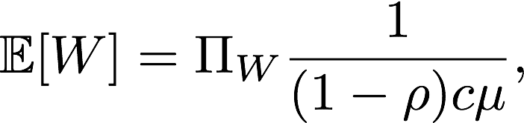
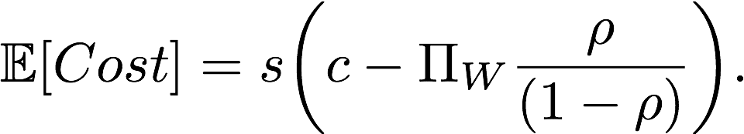
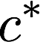
Queuing theory in brief
In an M/M/c queue served by c workers, the expected wait time is
And the expected cost of the queue if workers are paid salary s is
We find the optimal queue size by minimizing a weighted average of the two.
⍴ = λ / (µ * c)
(traffic intensity)

Slide 37
Control theory in brief
Process variable: parameter of interest. We use our optimal crowd size .
PID control system: u_{k} is set according to current, past, and derivative of observed error.
Control Error (e_{t})
Action u_{k}
(# new workers)
-
Controller
System
Set Point
(c*)
Feedback
(actual pool size)

Slide 38
Approach
Model tasks, workloads, and worker behavior
Auto-scale the pool to match incoming tasks:
Queuing theory to model task processing
Control theory to adapt to changing workloads
Inter-pool worker transfer:
to maximize cost-efficiency and throughput
to assign workers to tasks they prefer
Evaluation:
Simulations on traces from a large scale retainer pool deployment
19x cheaper, 20% higher throughput
Takes worker preferences into account

Slide 39
Worker transfer between tenants
In a multi-tenant system, we can transfer workers between applications.
Workers have preferences for different tasks, and must be trained to work on new task types.
When is it worth it to do so? (impacts performance and worker preference).

Slide 40
Inter-pool transfers: performance
Idea: simulate the transfer, then use queuing theory to predict the effect on performance.
As a proxy for performance, we use time to clear the current queue.

Slide 41
Inter-pool transfers: performance
Application A
Application B
Estimated queue completion:
3 seconds
Estimated queue completion:
0 seconds
T3
T2
T1
Worker Pool
Worker Pool

Slide 42
Inter-pool transfers: performance
Application A
Application B
Estimated queue completion:
1.5 seconds
Estimated queue completion:
0 seconds
T3
T2
T1
Worker Pool
Worker Pool

Slide 43
Inter-pool transfers: performance
Application A
Application B
Estimated queue completion:
0.75 seconds
Estimated queue completion:
0 seconds
T3
T2
T1
Worker Pool
Worker Pool

Slide 44
Inter-pool transfers: performance
Application A
Application B
Estimated queue completion:
0.75 seconds
Estimated queue completion:
0 seconds
T3
T2
T1
Worker Pool
Worker Pool
Adjust for
training time!

Slide 45
Inter-pool transfers: preferences
Idea: simulate the transfer, then compute the net preference of the system.
Assumption: workers have a preference in [0, 1] for every task type.
Then net preference is the sum of each worker’s preference for the task they are working on.

Slide 46
Putting it all together
To decide on inter-pool transfers, we:

Slide 47
Putting it all together
To decide on inter-pool transfers, we:
Search the space of possible transfer sets

Slide 48
Putting it all together
To decide on inter-pool transfers, we:
Search the space of possible transfer sets
Simulate each transfer set and compute a performance and a preference score

Slide 49
Putting it all together
To decide on inter-pool transfers, we:
Search the space of possible transfer sets
Simulate each transfer set and compute a performance and a preference score
Pick the transfer set that maximizes the weighted average of the two scores.

Slide 50
Approach
Model tasks, workloads, and worker behavior
Auto-scale the pool to match incoming tasks:
Queuing theory to model task processing
Control theory to adapt to changing workloads
Inter-pool worker transfer:
to maximize cost-efficiency and throughput
to assign workers to tasks they prefer
Evaluation:
Simulations on traces from a large scale retainer pool deployment
19x cheaper, 20% higher throughput
Takes worker preferences into account

Slide 51
Trace Data
Data gathered from a live deployment of retainer pools on MTurk running image labeling tasks (Haas 2015)
~7k tasks, with task durations
~6k worker recruitments into the pool
~3k abandonments
Available online at https://thisisdhaas.com/clamshell_trace.html

Slide 52
Evaluation
Does the queuing theory + control theory approach to auto-scaling crowd pools improve the performance of the system?

Slide 53
Evaluation
Control-theoretic auto-scaling offers up to 20% higher throughput at 1/5th of the cost of reactive rule-based auto-scaling

Slide 54
Evaluation
Does transferring workers between pools improve efficiency?

Slide 55
Evaluation
Enabling inter-pool transfers improves throughput by 76% at 1/25th of the cost.

Slide 56
Evaluation
Does transferring workers between pools improve net worker preference?

Slide 57
Evaluation
Adding inter-pool transfers to the sytem improves net preference by 43%.

Slide 58
Evaluation
Overall, do Cioppino’s techniques improve performance and worker preferences for the tasks they are assigned?

Slide 59
Evaluation
Compared to a state-of-the-art baseline*, Cioppino exhibits an average of 20% higher throughput and 2.3X higher net preference at 1/20th of the cost.
* Which uses rule-based auto-scaling and no inter-pool worker transfers

Slide 60
Want more?
In the paper (but not this talk):
Discussion of the tradeoffs in optimizing crowd systems for performance
Adjusting for worker abandonment
Heuristics for reducing the search space of potential transfer sets
Detailed evaluation on simulated data

Slide 61
Cioppino: summary
Client Application
Client Application
Requests
Requests
Task Queue
Task Queue
Multi-tenant Crowd
T3
T2
T1
T1
Worker Pool
Worker Transfer
Worker Pool
Worker
Recruitment
Worker Abandonment
Worker Abandonment
Crowd Platform

Slide 62
Thanks!
Cioppino:
Manage multi-tenant crowd pools
Queuing theory to model task processing
Control theory to adapt to workload changes
Inter-pool transfers to maximize efficiency
On trace data from a large-scale deployment:
20% higher throughput
19X cheaper
2X better aligned w/ worker preferences
dhaas@berkeley.edu

Slide 64
Backup Slides

Slide 65
Humans process a lot of data
“participants reported hundreds of employees deploying hundreds of thousands of tasks per week, with overall spending in the millions of dollars per year.
”
A. Marcus and A. Parameswaran. Crowdsourced data management: industry and academic perspectives. Foundations and Trends in Databases, 2015.

Slide 66


Enter the microtask
YES
NO

Slide 67
But human workers are not as fast as computers.

Slide 68
But human workers are not as fast as computers.
But often they are fast enough.
Y
N

Slide 69
Inter-pool transfers: preference
Application A
Sum preference
0.8
Application B
Sum preference
1.7
T3
T2
T1
Worker Pool
Worker Pool
Prefs:
(0.8, 0.2)
Prefs:
(0.9, 0.1)
Prefs:
(0.3, 0.7)
Prefs:
(0.1, 0.9)
Net Preference
0.8 + 1.7 = 2.5

Slide 70
Inter-pool transfers: preference
Application A
Sum preference
1.7
Application B
Sum preference
1.6
T3
T2
T1
Worker Pool
Worker Pool
Prefs:
(0.8, 0.2)
Prefs:
(0.9, 0.1)
Prefs:
(0.3, 0.7)
Prefs:
(0.1, 0.9)
Net Preference
1.7+ 1.6 = 3.3

Slide 71
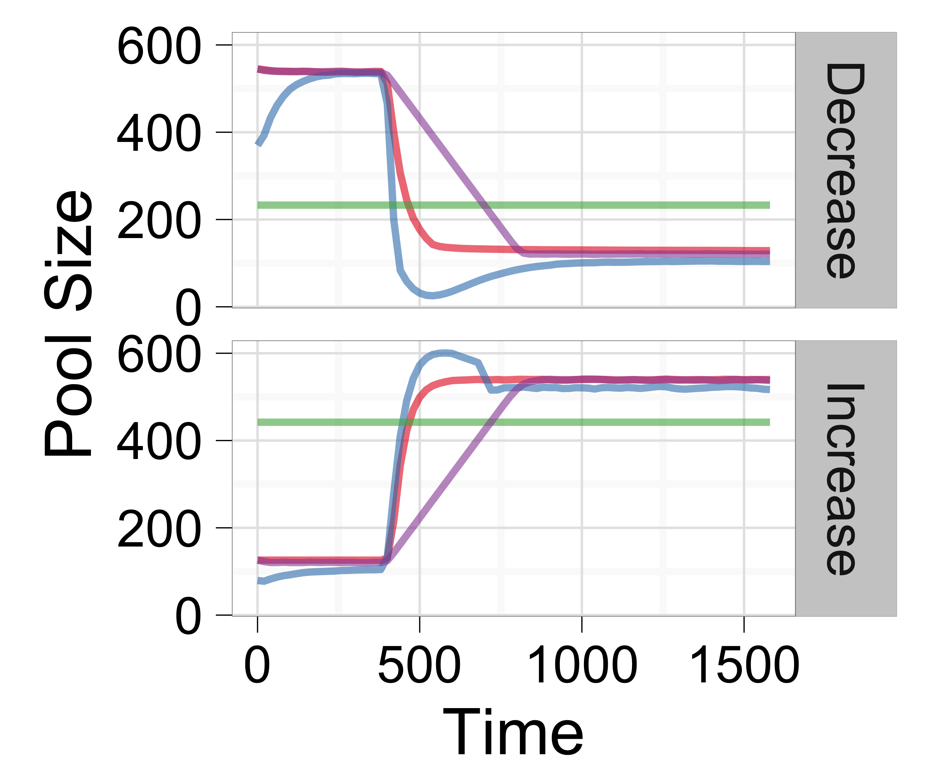
Evaluation: Autoscaling
Control + queuing theory
Control based on throughput
Rules + queuing theory
Workload-optimal static value

Slide 72
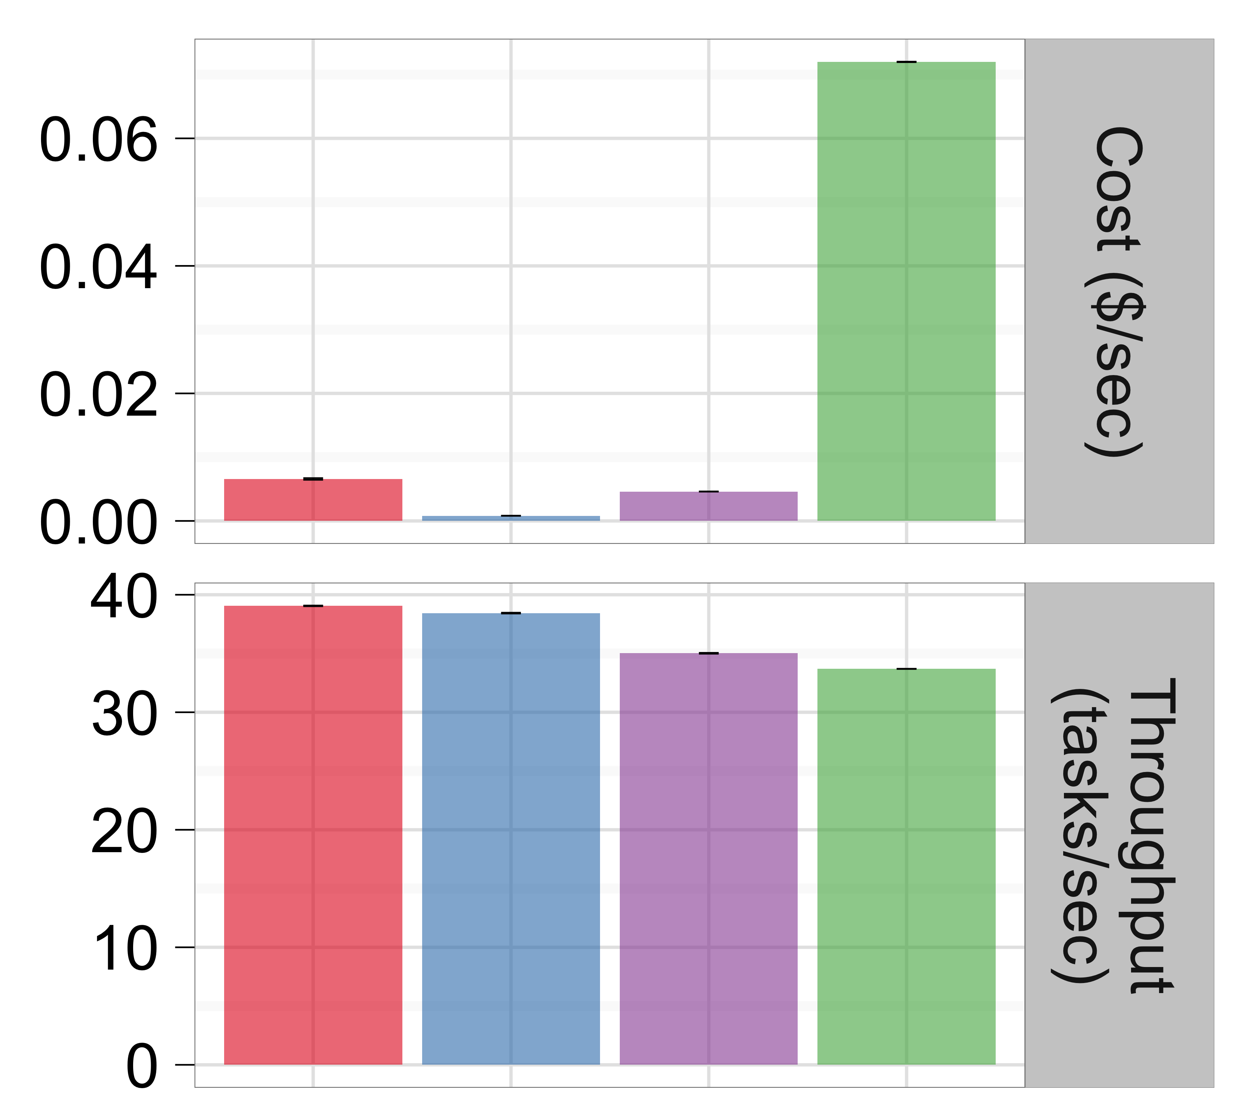
Evaluation: Autoscaling
Control + queuing theory
Control based on throughput
Rules + queuing theory
Workload-optimal static value
Controllers offer up to 20% higher throughput at
5-8X less cost (88X cheaper than static).

Slide 73
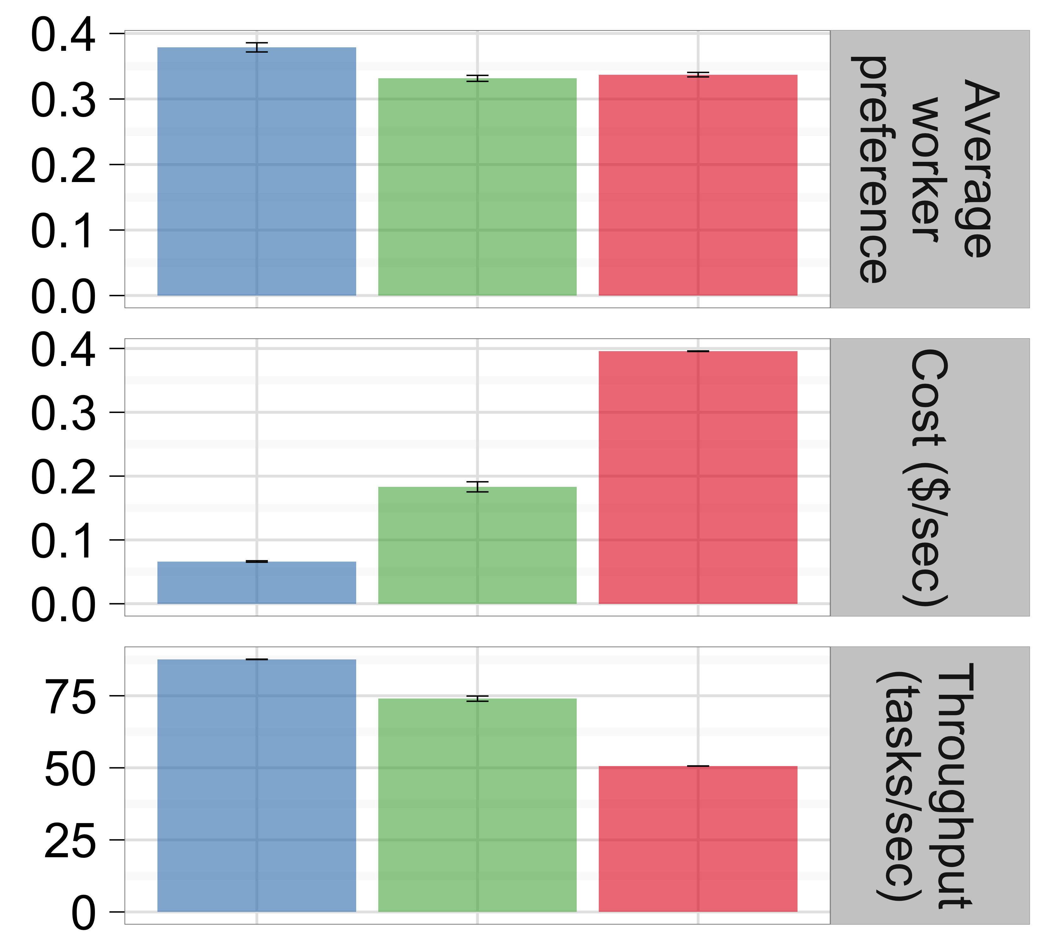
Evaluation: inter-pool transfers
Cioppino worker transfer
Random transfer
No worker transfer
Up to 76% higher throughput, 27X less cost,
43% higher net preference than
without inter-pool transfer.

Slide 74
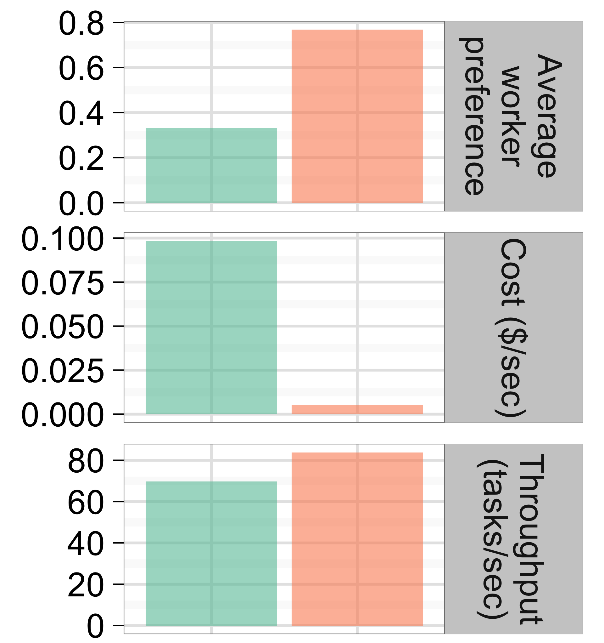
Evaluation: end-to-end
Cioppino
State-of-the-art baseline
Avg. 20% higher throughput, 19X less cost,
2.3X higher net preference than
state-of-the-art systems.

